Slide 1
Chapter 4 Transceiver Architectures
4.1 General Considerations
4.2 Receiver Architectures
4.3 Transmitter Architectures
4.4 OOK Transceivers
Behzad Razavi, RF Microelectronics.
Prepared by Bo Wen, UCLA

Slide 2
Chapter Outline
Heterodyne
Receivers
Direct-Conversion
Receivers
Problem of Image
Mixing Spurs
Sliding-IF RX
LO Leakage and Offsets
Even-Order Nonlinearity
I/Q Mismatch
Image-Reject and
Low-IF Receivers
Transmitter
Architecture
Hartley and Weaver Receivers
Low-IF Receivers
Polyphase Filters
TX Baseband Processing
Direct-Conversion TX
Heterodyne and Sliding-IF TX

Slide 3
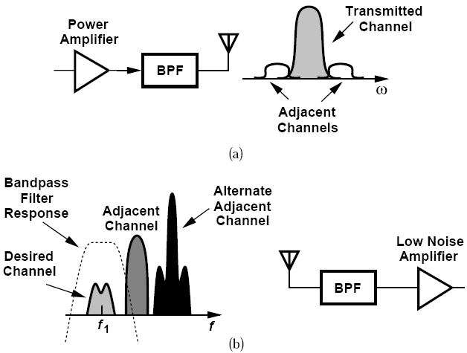
General Considerations: Narrow Channel Bandwidth
Narrow channel bandwidth impacts the RF design of the transceiver.

Slide 4
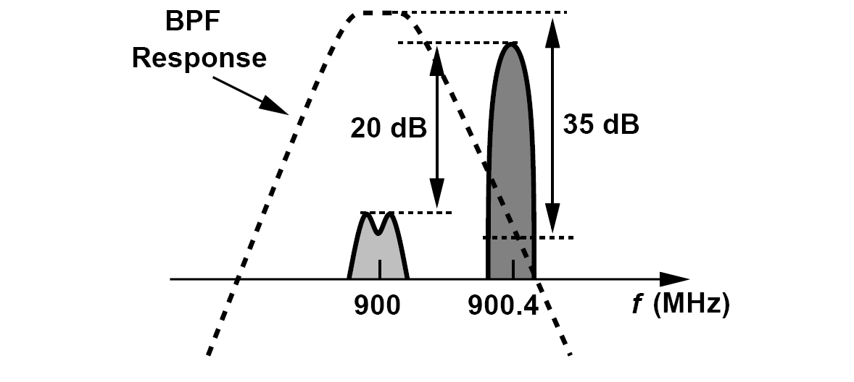
Can We Simply Filter the Interferers to Relax the Receiver Linearity Requirement?
First, the filter must provide a very high Q
Second, the filter would need a variable, yet precise center frequency

Slide 5
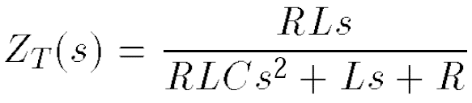
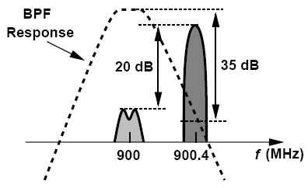

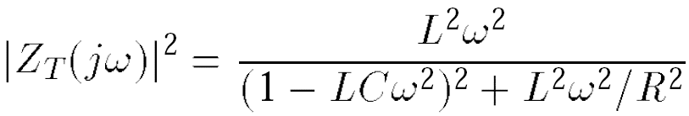
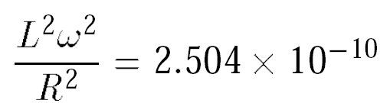

Example of Interferer-Suppressing Filter
A 900-MHz GSM receiver with 200-kHz channel spacing must tolerate an alternate adjacent channel blocker 20 dB higher than the desired signal. Calculate the Q of a second-order LC filter required to suppress this interferer by 35 dB.
Solution:
As shown in below, the filter frequency response must provide an attenuation of 35 dB at 400 kHz away from center frequency of 900MHz. For a second-order RLC tank, we write the impedance as

Slide 6
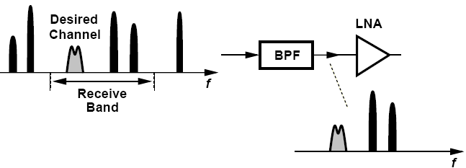
Channel Selection and Band Selection
All of the stages in the receiver chain that precede channel-selection filtering must be sufficiently linear
Channel selection must be deferred to some other point where center frequency is lower and hence required Q is more reasonable
Most receiver front ends do incorporate a “band-select” filter

Slide 7
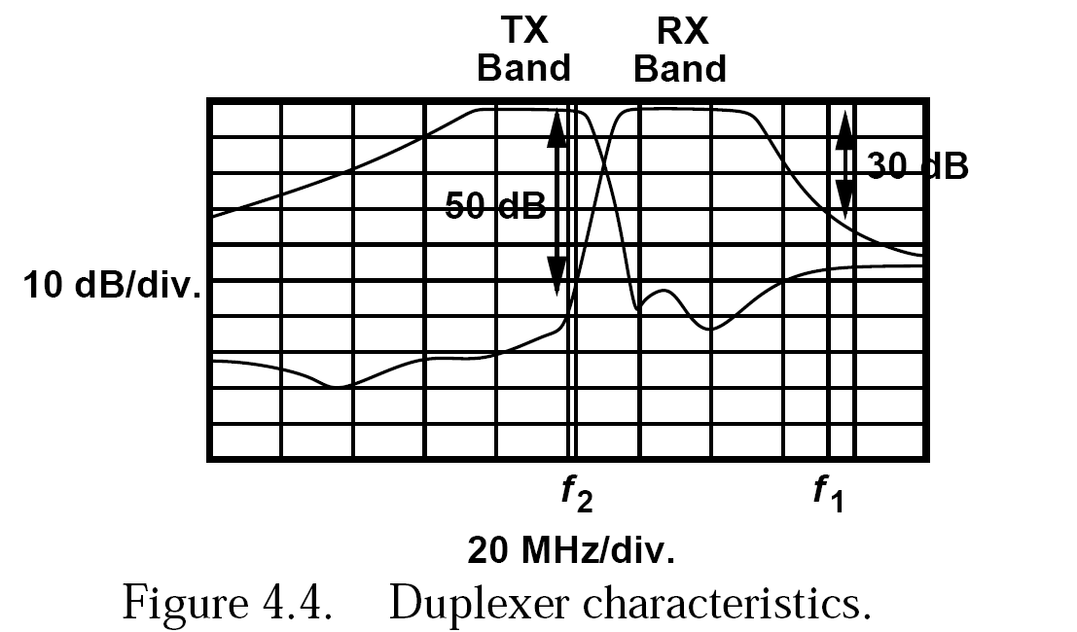
Duplexer Characteristics
The front-end band-select filter suffers from a trade-off between its selectivity and its in-band loss because the edges of the band-pass frequency response can be sharpened only by increasing the order of the filter.
Front-end loss directly raises the NF of the entire receiver

Slide 8
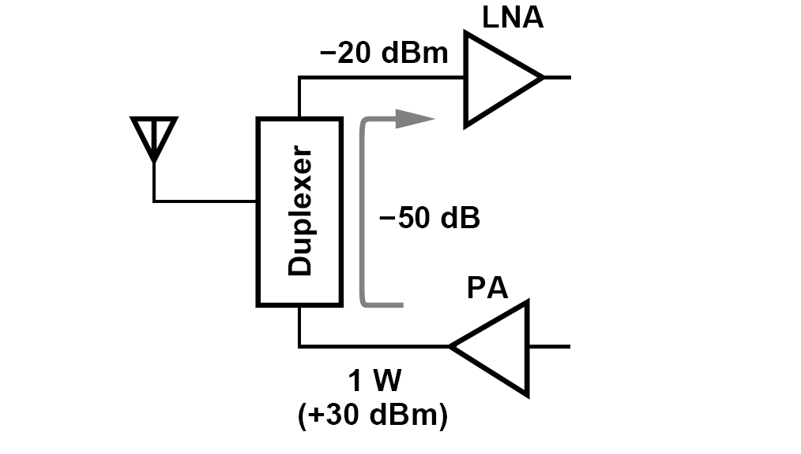
TX-RX Feedthrough
In full-duplex standards, the TX and the RX operate concurrently.
With a 1-W TX power, the leakage sensed by LNA can reach -20dBm, dictating a substantially higher RX compression point.

Slide 9
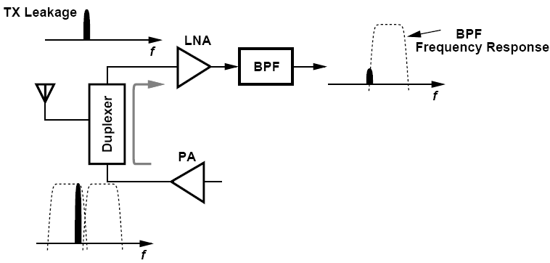
An Example of TX-RX Leakage
Explain how a band-pass filter following the LNA can alleviate the TX-RX leakage in a CDMA system.
Solution:
As depicted in below, if the BPF provides additional rejection in the TX band, the linearity required of the rest of the RX chain is proportionally relaxed. The LNA compression point, however, must still be sufficiently high.

Slide 10
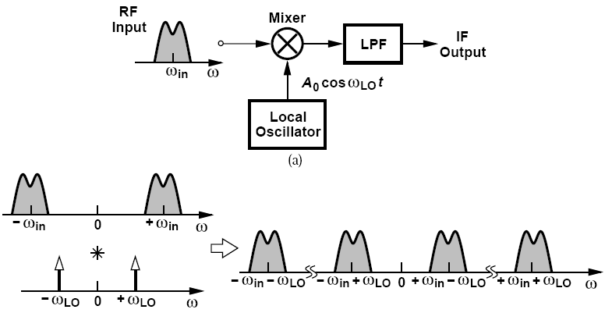
Basic Heterodyne Receivers
“Heterodyne” receivers employ an LO frequency unequal to ω_{in} and hence a nonzero IF
A Mixer performing downconversion.
Due to its high noise, the downconversion mixer is preceded by a low-noise amplifier

Slide 11
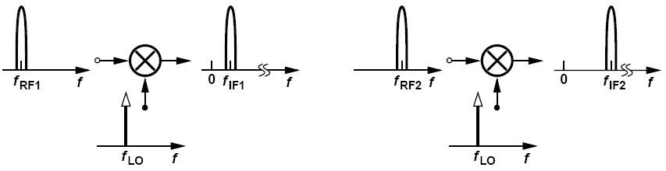
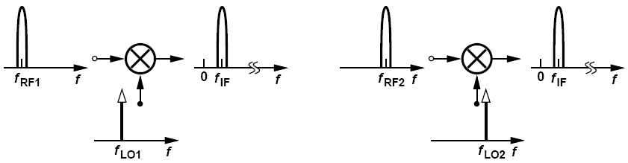
How Does a Heterodyne Receiver Cover a Given Frequency Band?
Constant LO: each RF channel is downconverted to a different IF channel
Constant IF: LO frequency is variable, all RF channels within the band of interest translated to a single value of IF.

Slide 12
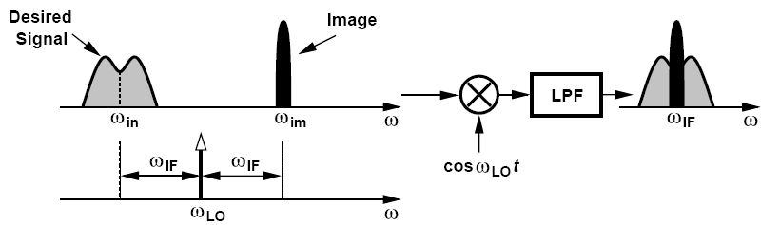
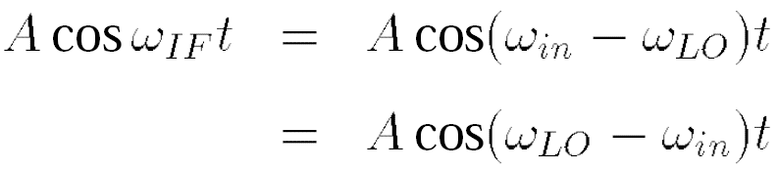
Basic Heterodyne Receivers: Problem of Image
Two spectra located symmetrically around ω_{LO} are downconverted to the IF

Slide 13
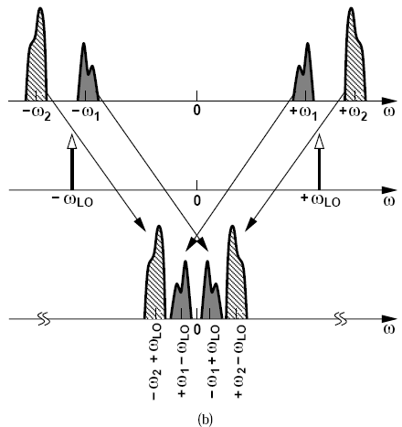
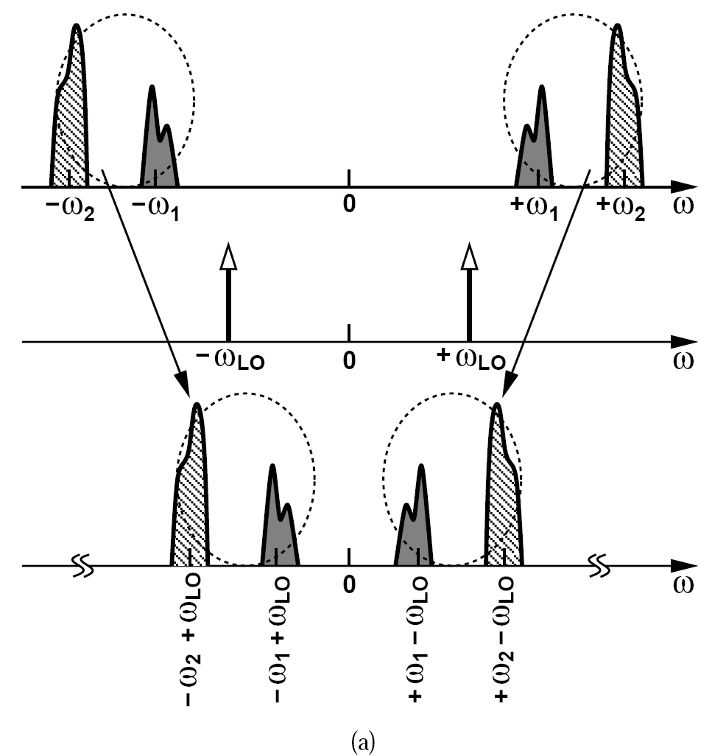
An Example of Image (Ⅰ)
Suppose two channels at ω₁ and ω₂ have been received and ω₁ < ω₂. Study the downconverted spectrum as the LO frequency varies from below ω₁ to above ω₂.
Solution:
ω_{LO} < ω₁ ω_{LO} slightly above ω₁

Slide 14
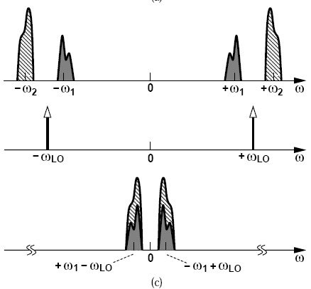
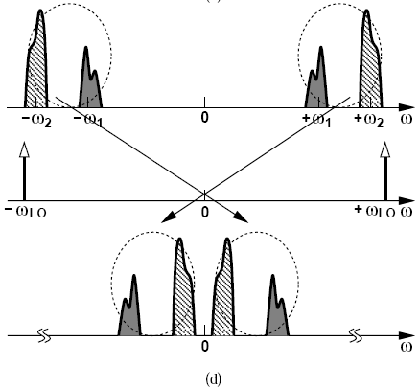
An Example of Image (Ⅱ)
Suppose two channels at ω₁ and ω₂ have been received and ω₁ < ω₂. Study the downconverted spectrum as the LO frequency varies from below ω₁ to above ω₂.
Solution:
ω_{LO} midway between ω₁ and ω₂ ω_{LO} > ω₂

Slide 15

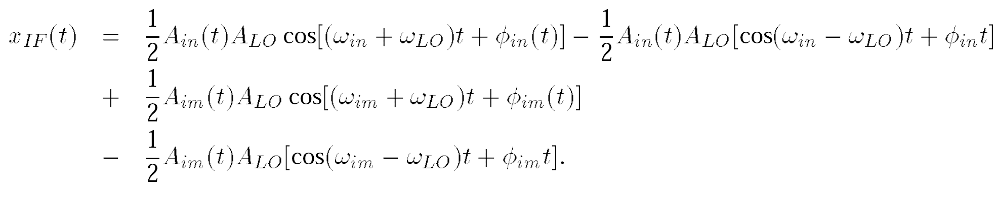
Another Example of Image
Formulate the downconversion above using expressions for the desired signal and the image.
Solution:
and
We observe that the components at ω_{in} +ω_{LO} and ω_{im} +ω_{LO} are removed by low-pass filtering, and those at ω_{in} - ω_{LO} = -ω_{IF} and ω_{im} - ω_{LO} = +ω_{IF} coincide.

Slide 16
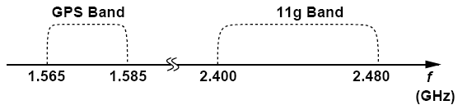
An Example of High-Side and Low-Side Injection
The designer of an IEEE802.11g receiver attempts to place the image frequency in the GPS band, which contains only low-level satellite transmissions and hence no strong interferers. Is this possible?
Solution:
The two bands are shown below. The LO frequency must cover a range of 80MHz but, unfortunately, the GPS band spans only 20 MHz. For example, if the lowest LO frequency is chosen so as to make 1.565 GHz the image of 2.4 GHz, then 802.11g channels above 2.42 GHz have images beyond the GPS band.

Slide 17
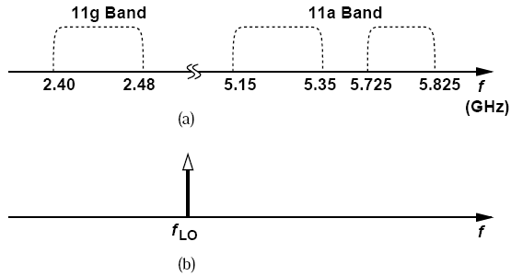
Another Example of High-Side and Low-Side Injection
A dual-mode receiver is designed for both 802.11g and 802.11a. Can this receiver operate with a single LO?
The following figure (top) depicts the two bands. We choose the LO frequency halfway between the two so that a single LO covers the 11g band by high-side injection and the 11a band by low-side injection. This greatly simplifies the design of the system, but makes each band the image of the other. For example, if the receiver is in the 11a mode while an 11g transmitter operates in close proximity, the reception may be heavily corrupted. Note that also the IF in this case is quite high, an issue revisited later.

Slide 18
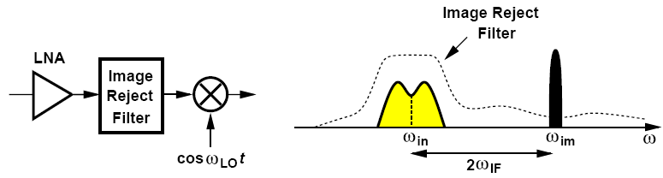
Image Rejection
The most common approach is to precede the mixer with an “image-reject filter”
A filter with high image rejection typically appears between the LNA and the mixer so that the gain of the LNA lowers the filter’s contribution to the receiver noise figure
The linearity and selectivity required of the image-reject filter have dictated passive, off-chip implementations.

Slide 19
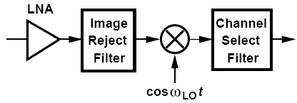
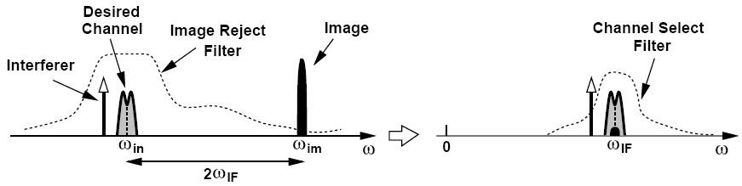
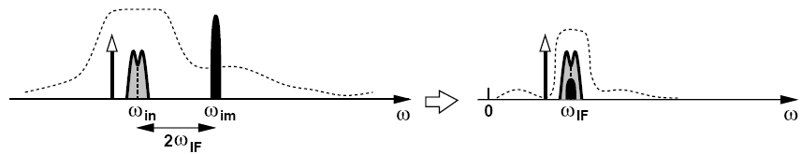
Image Rejection versus Channel Selection
A high IF allows substantial rejection of the image.
A low IF helps with the suppression of in-band interferers.

Slide 20
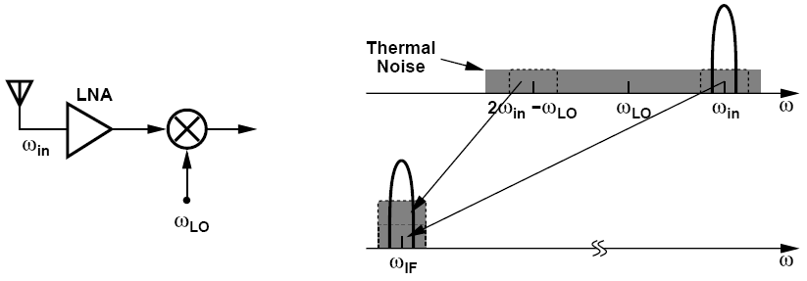
An Example of Noise Figure in Receiver
An engineer is to design a receiver for space applications with no concern for interferers. The engineer constructs the heterodyne front end shown in figure below (left), avoiding band-select and image-select filters. Explain why this design suffers from a relatively high noise figure.
Even in the absence of interferers, the thermal noise produced by the antenna and the LNA in the image band arrives at the input of the mixer. Thus, the desired signal, the thermal noise in the desired channel, and the thermal noise in the image band are downconverted to IF, leading to a higher noise figure for the receiver (unless the LNA has such a limited bandwidth that it suppresses the noise in the image band). An image-reject filter would remove the noise in the image band. We return to this effect in Chapter 6.

Slide 21
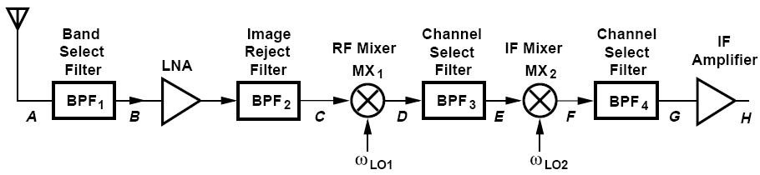
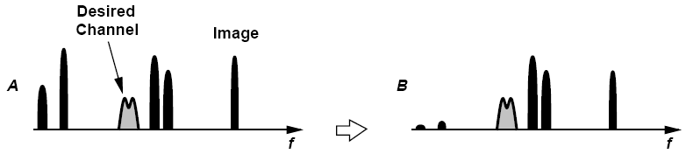
Dual Downconversion (Ⅰ)
The front-end filter selects the band while providing some image rejection as well (Point B)

Slide 22
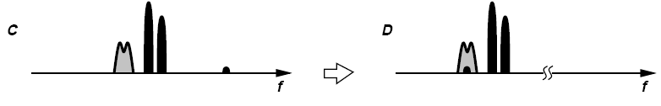

Dual Downconversion (Ⅱ)
After amplification and image-reject filtering, spectrum of C obtained
Sufficiently linear mixer translates desired channel and adjacent interferers to first IF (Point D)
Partial channel selection BPF₃ permits the use of a second mixer with reasonable linearity. (Point E)
Spectrum is translated to second IF. (Point F)

Slide 23
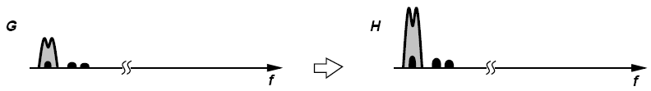
Receiver Architectures
BPF₄ suppresses the interferers to acceptably low levels (Point G)
An optimum design scales both the noise figure and the IP3 of each stage according to the total gain preceding that stage.

Slide 24
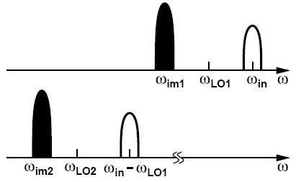
Another Example of Image
Assuming low-side injection for both downconversion mixers in figure above, determine the image frequencies.
Solution:
As shown below, the first image lies at 2ω_{LO1} -ω_{in}. The second image is located at 2ω_{LO2} - (ω_{in} - ω_{LO1}).

Slide 25
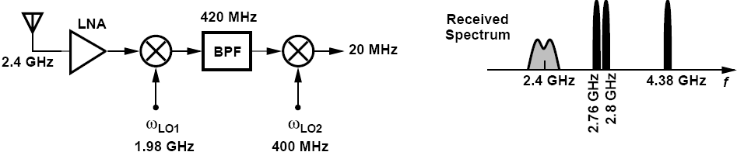
Mixing Spurs and an Example
Figure below (left) shows a 2.4-GHz dual downconversion receiver, where the first LO frequency is chosen so as to place the (primary) image in the GPS band for some of the channels. Determine a few mixing spurs.
Let us consider the second harmonic of LO₂, 800MHz. If an interferer appears at the first IF at 820MHz or 780MHz, then it coincides with the desired signal at the second IF. In the RF band, the former corresponds to 820MHz+1980MHz = 2.8 GHz and the latter arises from 780MHz+1980MHz = 2.76 GHz. We can also identify the image corresponding to the second harmonic of LO₁ by writing f_{in} - 2f_{LO1} - f_{LO2} = 20 MHz and hence f_{in} = 4.38 GHz. Figure above (right) summarizes these results. We observe that numerous spurs can be identified by considering other combinations of LO harmonics.
Mixing Spurs
RF input multiplied by a square-wave LO. Producing harmonics.
If an interferer is downconverted to the same IF, it corrupts the signal

Slide 26
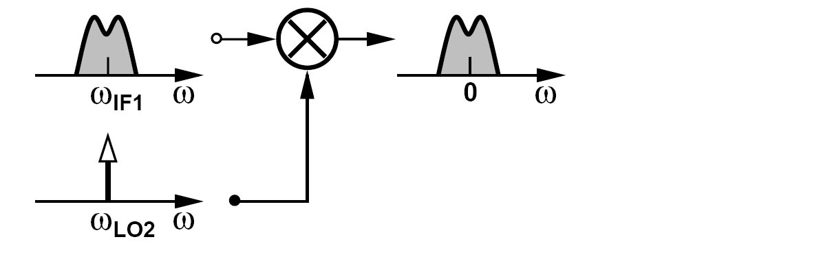
Zero Second IF
To avoid secondary image, most modern heterodyne receivers employ a zero second IF.
In this case, the image is the signal itself. No interferer at other frequencies can be downconverted as an image to a zero center frequency if ω_{LO2}=ω_{IF1}

Slide 27
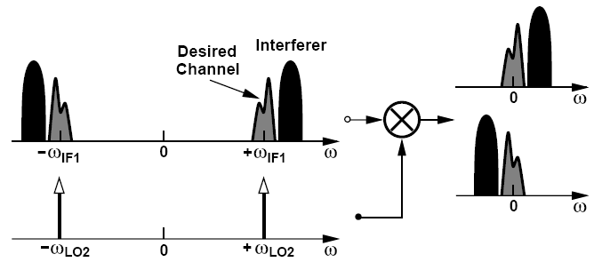
Example of Zero Second IF
Suppose the desired signal in figure above is accompanied by an interferer in the adjacent channel. Plot the spectrum at the second IF if ω_{LO2} = ω_{IF1}.
As shown below, the desired channel appears at ± ω_{IF1} and is accompanied by the interferer. Upon mixing in the time domain, the spectrum at negative frequencies is convolved with the LO impulse at +ω_{LO2}, sliding to a zero center frequency for the desired
channel. Similarly, the spectrum at positive frequencies is convolved with the impulse at -ω_{LO2} and shifted down to zero. The output thus consists of two copies of the desired channel surrounded by the interferer spectrum at both positive and negative frequencies.

Slide 28
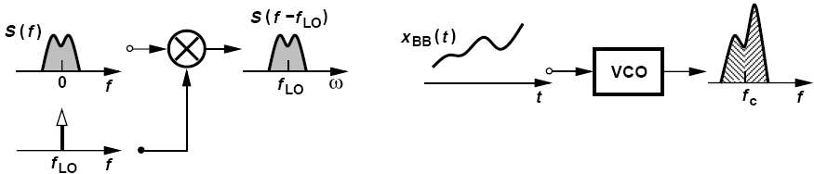
Symmetrically-modulated versus Asymmetrically-modulated Signal
AM signal generation FM signal generation
AM signals are symmetric, FM signals are asymmetric.
Most of today’s modulation schemes, e.g., FSK, QPSK, GMSK, and QAM, exhibit asymmetric spectra around carrier frequency.

Slide 29
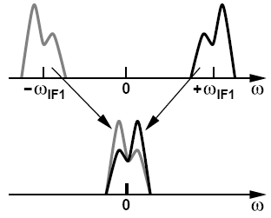
Corruption of the Asymmetric Signal Spectrum
Downconversion to a zero IF superimposes two copies of the signal
If the signal spectrum is asymmetric, the original signal spectrum will be corrupted

Slide 30
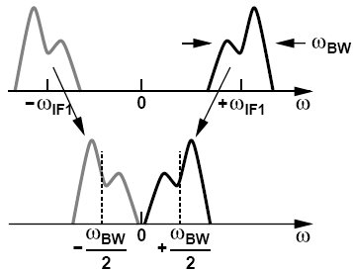
An Example of Self-corruption
Downconversion to what minimum intermediate frequency avoids self-corruption of asymmetric signals?
Solution:
To avoid self-corruption, the downconverted spectra must not overlap each other. Thus, as shown in figure below, the signal can be downconverted to an IF equal to half of the signal bandwidth. Of course, an interferer may now become the image.

Slide 31
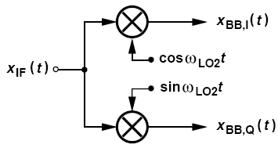
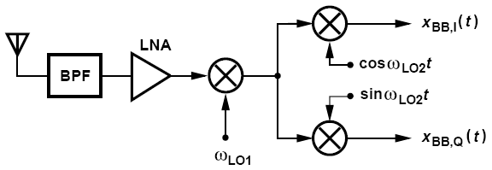
How can downconversion to a zero IF avoid self-corruption?
Quadrature downconversion
By creating two versions of the downconverted signal that have a phase difference of 90。

Slide 32
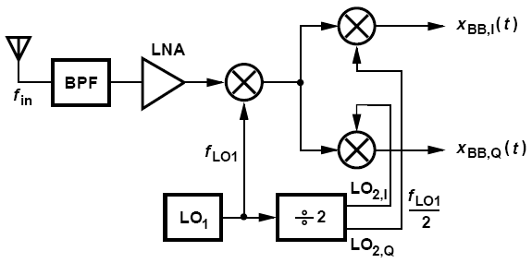
Sliding-IF Receivers
Modern heterodyne receivers employ only one oscillator
The second LO frequency is therefore derived from the first by “frequency division”

Slide 33
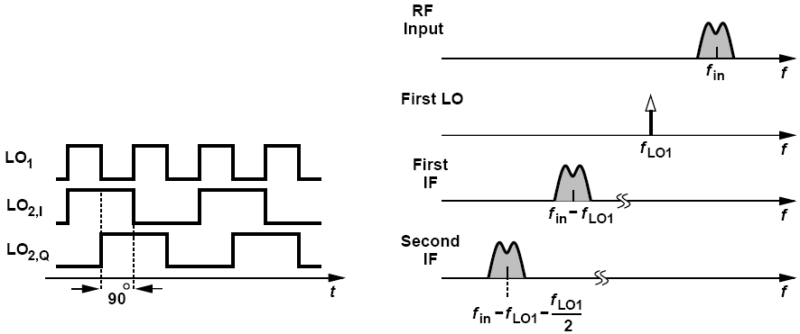
Sliding-IF Receivers: Divide-by-2 Circuit
Such divide-by-2 topology can produce quadrature output
The second LO waveforms at a frequency of f_{LO1}/2

Slide 34
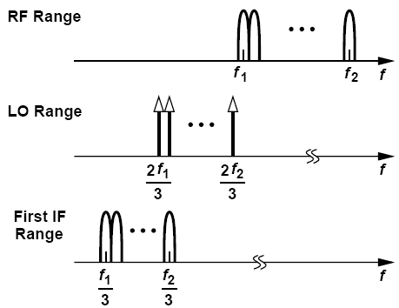
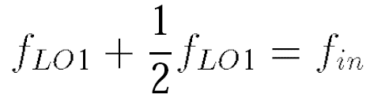
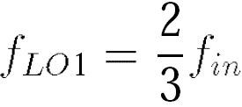
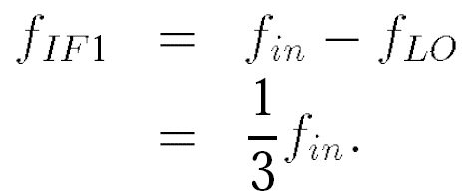
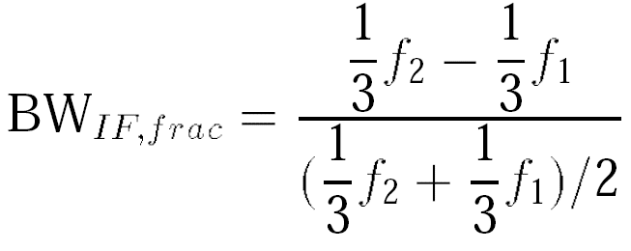
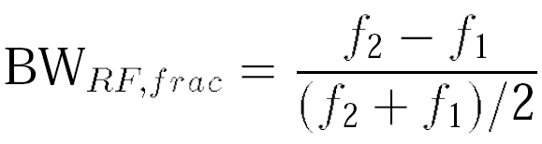
Interesting Properties of Sliding-IF Receivers
Fractional bandwidth:
IF
RF input

Slide 35
An Example of Sliding-IF Receivers
Suppose the input band is partitioned into N channels, each having a bandwidth of (f₂ - f₁)/N = Δf. How does the LO frequency vary as the receiver translates each channel to a zero second IF?
Solution:
The first channel is located between f₁ and f₁+Δf. Thus the first LO frequency is chosen equal to two-third of the center of the channel: f_{LO} = (2/3)(f₁ + Δf/2). Similarly, for the second channel, located between f₁ + Δf and f₁ + 2Δf, the LO frequency must be equal to (2/3)(f₁ + 3Δf/2). In other words, the LO increments in steps of (2/3)Δ f.

Slide 36
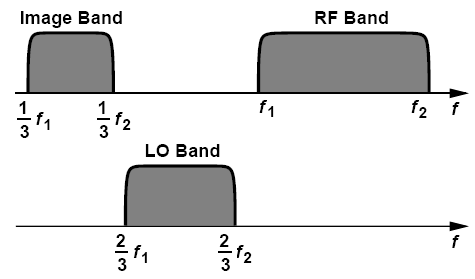
Another Example of Sliding-IF Receivers
With the aid of the frequency bands shown in figure above, determine the image band for the architecture of the sliding-IF heterodyne RX.
Solution:
For an LO frequency of (2/3)f₁, the image lies at 2f_{LO} - f_{in} = f₁/3. Similarly, if f_{LO1} = (2/3)f₂, then the image is located at f₂/3. Thus, the image band spans the range [f₁/3 f₂/3]. Interestingly, the image band is narrower than the input band.
Narrower image band than input band?
No, recall from the above example that the LO increments by (2/3)Δ f as we go from one channel to the next. Thus, consecutive image channels have an overlap of Δf/3.

Slide 37
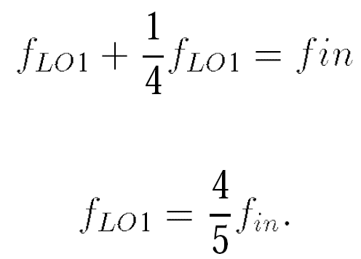
Sliding-IF Receivers with Divide Ratio of 4
May incorporate greater divide ratios, e.g., 4
Second LO f_{in}/5, slightly lower, desirable because generation of LO quadrature phases at lower frequencies incurs smaller mismatches
Reduces the frequency difference between the image and the signal, difficult to reject image.

Slide 38


An Example to Compare the Divide Ratio of 2 and 4
We wish to select a sliding-IF architecture for an 802.11g receiver. Determine the pros and cons of a ÷ 2 or a ÷ 4 circuit in the LO path.
Divide-by-2 circuit Divide-by-4 circuit
With a ÷2 circuit, the 11g band (2.40-2.48 GHz) requires an LO range of 1.600-1.653 GHz and hence an image range of 800-827 MHz. Unfortunately, since the CDMA transmit band begins at 824 MHz, such a sliding-IF receiver may experience a large image in the range of 824-827 MHz.
With a ÷4 circuit, the LO range is 1.920-1.984 GHz and the image range, 1.440-1.488 GHz. This image band is relatively quiet. (Only Japan has allocated a band around 1.4 GHz to WCDMA.) Thus, the choice of the ÷4 ratio proves advantageous here if the LNA selectivity can suppress the thermal noise in the image band. The first IF is lower in the second case and may be beneficial in some implementations.

Slide 39

Direct-Conversion Receivers
Absence of an image greatly simplifies the design process
Channel selection is performed by on-chip low-pass filter
Mixing spurs are considerably reduced in number

Slide 40

LO Leakage
LO couples to the antenna through:
(a)device capacitances between LO and RF ports of mixer and device capacitances or resistances between the output and input of the LNA
(b)the substrate to the input pad, especially because the LO employs large on-chip spiral inductors

Slide 41


An Example of LO Leakage
Determine the LO leakage from the output to the input of a cascode LNA.
Solution:
If g_{m2} >> 1/ r_{O2}

Slide 42

Cancellation of LO Leakage
LO leakage can be minimized through symmetric layout of the oscillator and the RF signal path
LO leakage arises primarily from random or deterministic asymmetries in the circuits and the LO waveform

Slide 43

DC Offsets
A finite amount of in-band LO leakage appears at the LNA input. Along with the desired signal, this component is amplified and mixed with LO.
May saturates baseband circuits, simply prohibiting signal detection.

Slide 44


An Example of DC Offsets
A direct-conversion receiver incorporates a voltage gain of 30 dB from the LNA input to each mixer output and another gain of 40 dB in the baseband stages following the mixer. If the LO leakage at the LNA input is equal to -60 dBm, determine the offset voltage at the output of the mixer and at the output of the baseband chain.
Solution:
What does A_{V1} = 30 dB mean? If a sinusoid V₀ cos ω_{in}t is applied to the LNA input, then the baseband signal at the mixer output, V_{bb} cos(ω_{in} - ω_{LO})t, has an amplitude given by
Thus, for an input V_{leak} cos ω_{LO}t,
the dc value at the mixer output is equal to
Since A_{V1} = 31.6 and V_{leak} = (632/2) μV,
we have V_{dc} = 10 mV.
Amplified by another 40 dB,
this offset reaches 1 V at the baseband output!

Slide 45

Another Example of DC Offsets
The dc offsets measured in the baseband I and Q outputs are often unequal. Explain why
Solution:
Suppose, in the presence of the quadrature phases of the LO, the net LO leakage at the input of the LNA is expressed as V_{leak} cos(ω_{LO}t+Φ_{leak} ), where Φ_{leak} arises from the phase shift through the path(s) from each LO phase to the LNA input and also the summation of the leakages V_{LO} cos ω_{LO}t and V_{LO} sinω_{LO}t . The LO leakage travels through the LNA and each mixer, experiencing an additional phase shift, Φ_{ckt}, and is multiplied by V_{LO} cos ω_{LO}t and V_{LO} sin ω_{LO}t. The dc components are therefore given by Thus, the two dc offsets are generally unequal.

Slide 46


Cancellation of DC Offsets
Offset cancellation: high-pass filter
Such network also removes a fraction of the signal’s spectrum near zero frequency, introducing intersymbol interference
Modulation schemes that contain little energy around the carrier better lend themselves to ac coupling in the baseband.
A drawback of ac coupling stems from its slow response to transient input.
Small modulation index Large modulation index

Slide 47



Another Method of Suppressing DC Offsets (Ⅰ)
Figure below shows another method of suppressing dc offsets in the baseband. Here, the main signal path consists of G_{m1} (a transconductance amplifier), R_{D}, and A₁, providing a total voltage gain of G_{m1}R_{D}A₁. The negative feedback branch comprising R₁, C₁ and -G_{mF} returns a low-frequency current to node X so as to drive the dc content of V_{out} toward zero. Note that this topology suppresses the dc offsets of all of the stages in the baseband. Calculate the corner frequency of the circuit.
Solution:
Recognizing that the current returned by -G_{mF} to node X is equal to –G_{mF} V_{out}=(R₁C₁s + 1) and the current produced by G_{m1} is given by G_{m1}V_{in}, we sum the two at node X, multiply the sum by R_{D} and A₁, and equate the result to V_{out}
It follows:

Slide 48


Another Method of Suppressing DC Offsets (Ⅱ)
The circuit thus exhibits a pole at -(1+G_{mF}R_{D}A₁)/(R₁C₁) and a zero at -1/(R₁C₁). The input offset is amplified by a factor of G_{m1}R_{D}A₁/(1+G_{mF}R_{D}A₁) ≈ G_{m1}/G_{mF} if G_{mF}R_{D}A₁ >> 1. This gain must remain below unity, i.e., G_{mF} is typically chosen larger than G_{m1}. Unfortunately, the high-pass corner frequency is given by
a factor of G_{mF}R_{D}A₁ higher than that of the passive circuit mentioned before. This “active feedback” circuit therefore requires greater values for R₁ and C₁ to provide a low f₁. The advantage is that C₁ can be realized by a MOSFET.

Slide 49

Offset Cancellation Employing DACs to Draw Corrective Current
The entire negative-feedback loop converges such that V_{out} is minimized. The resulting values are then stored in the register and remain frozen during the actual operation of the receiver.
The principal drawback of digital storage originates from the finite resolution with which the offset is cancelled. A higher resolution or multiple DACs can be tied to different nodes to alleviate this issue.

Slide 50

Even-Order Distortion: an Overview
Direct-conversion receivers are additionally sensitive to even-order nonlinearity in the RF path, and so are heterodyne architectures having a second zero IF.
Asymmetries in the mixer or in the LO waveform allow a fraction of the RF input of the mixer to appear at the output without frequency translation, corrupting the downconverted signal.
The beat generated by the LNA can be removed by ac coupling, making the input transistor of the mixer the dominant source of even-order distortion.

Slide 51




How Asymmetries Give Rise to Direct “Feedthrough”
First consider the circuit shown left. The output can be written as the product of V_{in} and an ideal LO, S(t).
Thus, V_{in}(t) · [S(t) – 1/2] contains the product of Vin and the odd harmonics of the LO. The second term, V_{in}(t) × 1/2, denotes the RF feedthrough to the output
Next, consider the circuit shown right. We have
If the output is sensed differentially, the RF feedthroughs in V_{out1}(t) and V_{out2}(t) are cancelled while the signal components add. It is this cancellation that is sensitive to asymmetries.

Slide 52


Second Intercept Point (IP₂)
If V_{in}(t) = Acos ω₁t + Acos ω₂t, then the LNA output is given by
Beat amplitude grows with the square of the amplitude of the input tones.

Slide 53


Example of Calculation of IP₂
Since the feedthrough of the beat depends on the mixer and LO asymmetries, the beat amplitude measured in the baseband depends on the device dimensions and the layout and is therefore difficult to formulate.
Suppose the attenuation factor experienced by the beat as it travels through the mixer is equal to k whereas the gain seen by each tone as it is downconverted to the baseband is equal to unity. Calculate the IP₂.
Solution:
From equation above, the value of A that makes the output beat amplitude, kα₂A2, equal to the main tone amplitude, α₁A, is given by
hence

Slide 54


Even-Order Distortion in the Absence of Interferers
We express the signal as x_{in}(t) = [A₀+a(t)] cos[ω_{c}t+Φ(t)], where a(t) denotes the envelope and typically varies slowly, i.e., it is a low-pass signal.
Both of the terms α₂A₀a(t) and α₂a2(t)/2 are low-pass signals and, like the beat component, pass through the mixer with finite attenuation, corrupting the downconverted signal.
Quantify the self-corruption expressed by equation above in terms of the IP₂.
Assume, that the low-pass components,α₂A₀a(t)+α₂a2(t)=2, experience an attenuation factor of k and the desired signal, α₁A₀, sees a gain of unity. Also, typically a(t) is several times smaller than A₀ and hence the baseband corruption can be approximated as kα₂A₀a(t). Thus, the signal-to-noise ratio arising from self-corruption is given by

Slide 55



Even-Order Distortion with a Large AM Interferer
Even-order distortion demodulates the AM component of the interferer, and mixer feedthrough allows it to appear in the baseband.
A desired signal at -100 dBm is received along with an interferer [A_{int} + a(t)] cos[ω_{c}t + Φ(t)], where A_{int} = 5 mV and a_{rms} = 1 mV. What IP₂ is required to ensure SNR ≥ 20 dB?

Slide 56






Flicker Noise
Since the signal is centered around zero frequency, it can be substantially corrupted by flicker noise.
We note that if S_{1/f} = α/f, then at f_{c},
An 802.11g receiver exhibits a baseband flicker noise corner frequency of 200 kHz. Determine the flicker noise penalty
We have f_{BW} = 10 MHz, f_{c} = 200 kHz, and hence

Slide 57




Example of GSM Receiver Flicker Noise Penalty
A GSM receiver exhibits a baseband flicker noise corner frequency of 200 kHz. Determine the flicker noise penalty.
Figure below plots the baseband spectra, implying that the noise must be integrated up to 100 kHz. Assuming a lower end equal to about 1/1000 of the bit rate, we write the total noise as
Without flicker noise,
That is, the penalty reaches

Slide 58


I/Q Mismatch: Sources
Separation into quadrature phases can be accomplished by shifting either the RF signal or the LO waveform by 90°.
Errors in the 90° phase shift circuit and mismatches between the quadrature mixers result in imbalances in the amplitudes and phases of the baseband I and Q outputs.

Slide 59

I/Q Mismatch in Direct-Conversion Receivers And Heterodyne Topologies
Quadrature mismatches tend to be larger in direct-conversion receivers than in heterodyne topologies.
This occurs because
(1) the propagation of a higher frequency (f_{in}) through quadrature mixers experiences greater mismatches;
(2) the quadrature phases of the LO itself suffer from greater mismatches at higher frequencies;

Slide 60




Effect of I/Q Mismatch (Ⅰ)
Let us lump all of the gain and phase mismatches shown below:

Slide 61


Effect of I/Q Mismatch (Ⅱ)
We now examine the results for two special cases:
(1) ε ≠ 0, θ = 0 : the quadrature baseband symbols are scaled differently in amplitude,
(2) ε = 0, θ ≠ 0 : each baseband output is corrupted by a fraction of the data symbols in the other output

Slide 62


Example of I/Q Mismatch (Ⅰ)
An FSK signal is applied to a direct-conversion receiver. Plot the baseband waveforms and determine the effect of I/Q mismatch.
We express the FSK signal as x_{FSK}(t) = A₀ cos[(ω_{c} + aω₁)t], where a = ± 1 represents the binary information; i.e., the frequency of the carrier swings by +ω₁ or -ω₁. Upon multiplication by the quadrature phases of the LO, the signal produces the following baseband components:
Figure on the right illustrates the results: if the carrier frequency is equal to ω_{c} + ω₁ (i.e., a = +1), then the rising edges of x_{BB,I}(t) coincide with the positive peaks of x_{BB,Q}(t). Conversely, if the carrier frequency is equal to ω_{c} - ω₁, then the rising edges of x_{BB,I}(t) coincide with the negative peaks of x_{BB,Q}(t).

Slide 63


Example of I/Q Mismatch (Ⅱ)
An FSK signal is applied to a direct-conversion receiver. Plot the baseband waveforms and determine the effect of I/Q mismatch.
Thus, the binary information is detected if x_{BB,I}(t) simply samples x_{BB,Q}(t), e.g., by means of a D flipflop.
The waveforms above suggest that FSK can tolerate large I/Q mismatches: amplitude mismatch proves benign so long as the smaller output does not suffer from degraded SNR, and phase mismatch is tolerable so long as x_{BB,I}(t) samples the correct polarity of x_{BB,Q}(t). Of course, as the phase mismatch approaches 90_, the additive noise in the receive chain introduces errors.

Slide 64

Requirement of I/Q Mismatch
For complex signal waveforms such as OFDM with QAM, the maximum tolerable I/Q mismatch can be obtained by simulations
The bit error rate is plotted for different combinations of gain and phase mismatches, providing the maximum mismatch values that affect the performance negligibly.
For example, in a system employing OFDM with 128 subchannels and QPSK modulation in each subchannel shown on right, we observe that gain/phase mismatches below -0.6 dB/6° have negligible effect.

Slide 65


Computation and Correction I/Q Mismatch
In many high performance systems, the quadrature phase and gain must be calibrated—either at power-up or continuously.
Calibration at power-up can be performed by applying an RF tone at the input of the quadrature mixers and observing the baseband sinusoids in the analog or digital domain
With the mismatches known, the received signal constellation is corrected before detection.

Slide 66


Image-Reject Receivers: 90 °Phase Shift—Cosine Signal
Before studying these architectures, we must define a “shift-by-90 °” operation.
The impulse at +ω_{c} is rotated clockwise and that at –ω_{c} counterclockwise

Slide 67



Image-Reject Receivers: 90 °Phase Shift—Modulated Signal
Similarly, for a narrowband modulated signal:
We write in the frequency domain:
The shift-by-90 ° operation is also called the “Hilbert transform”.

Slide 68

Examples of Hilbert Transform
In phasor diagrams, we simply multiply a phasor by -j to rotate it by 90° clockwise. Is that inconsistent with the Hilbert transform?
No, it is not. A phasor is a representation of Aexp(jω_{c}t), i.e., only the positive frequency content. That is, we implicitly assume that if Aexp(jω_{c}t) is multiplied by -j, then Aexp(-jω_{c}t) is also multiplied by +j.
Plot the spectrum of Acos ω_{c}t + jA sinω_{c}t.
Multiplication of the spectrum of Asinω_{c}t by j rotates both impulses by 90 ° counterclockwise. Upon adding this spectrum to that Acos ω_{c}t, we obtain the one-sided spectrum shown below (right). This is, of course, to be expected because Acos ω_{c}t + jA sinω_{c}t = Aexp(-jω_{c}t), whose Fourier transform is a single impulse located at ω = +ω_{c}.

Slide 69

Example of I + jQ
A narrowband signal I(t) with a real spectrum is shifted by 90 ° to produce Q(t). Plot the spectrum of I(t) + jQ(t).
We first multiply I(ω) by -jsgn(ω) and then, in a manner similar to the previous example, multiply the result by j. The spectrum of jQ(t) therefore cancels that of I(t) at negative frequencies and enhances it at positive frequencies. The one-sided spectrum of I(t) + jQ(t) proves useful in the
analysis of
transceivers.

Slide 70


Implementation of the 90° Phase Shift
The high-pass and low-pass transfer functions are respectively given by:
We can therefore consider V_{out2} as the Hilbert transform of V_{out1} at frequencies close to (R₁C₁)-1

Slide 71

Another Approach to Implement the 90° Phase Shift
The RF input is mixed with the quadrature phases of the LO so as to translate the spectrum to a non-zero IF.
The IF spectrum emerging from the lower arm is the Hilbert transform of that from the upper arm.

Slide 72

Low-Side Injection of the Above Implementation
The realization above assumes high-side injection for the LO. Repeat the analysis for low-side injection.
Figures below show the spectra for mixing with cos ω_{LO}t and sin ω_{LO}t, respectively. In this case, the IF component in the lower arm is the negative of the Hilbert transform of that in the upper arm.

Slide 73

How Can the Image Components Cancel Each Other?
Is I(t) + Q(t) free from the image? Since the image components in Q(t) are 90° out of phase with respect to those in I(t), this summation still contains the image.

Slide 74

Hartley Architecture
If we shift I(t) or Q(t) by another 90 ° before adding them, the image may be removed.
The low-pass filters are inserted to remove the unwanted high-frequency components generated by the mixers

Slide 75

Operation of Hartley’s Architecture
We assume low-side injection and apply a 90° phase shift to the Hilbert transforms of the signal and the image (the Q arm)
.
Multiplication of Q_{sig} by -jsgn(ω) rotates and superimposes the spectrum of Q_{sig} on that of I_{sig}, doubling the signal amplitude. On the other hand, multiplication of Q_{im} by –jsgn(ω) creates the opposite of I_{im}, canceling the image.

Slide 76

Analytical Expression of Hartley’s Architecture
An eager student constructs the Hartley architecture but with high-side injection. Explain what happens.
We note that the quadrature converter takes the Hilbert transform of the signal and the negative Hilbert transform of the image. Thus, with another 90° phase shift, the outputs C and A in figure above contain the signal with opposite polarities and the image with the same polarity. The circuit therefore operates as a “signal-reject” receiver! Of course, the design is salvaged if the addition is replaced with subtraction.
Represent the received signal and image as x(t) = A_{sig} cos(ω_{c}t + Φ_{sig}) + A_{im} cos(ω_{im}t + Φ_{im}), obtaining the signal at point A and B:
It follows that:
Upon addition of x_{A}(t) and x_{C}(t), we retain the signal and reject the image.
The

Slide 77

Realization of 90 °Phase Shift of Hartley Architecture
The 90 ° phase shift depicted before is typically realized as a +45 ° shift in one path and -45 ° shift in the other.
This is because it is difficult to shift a single signal by 90 ° while circuit components vary with process and temperature.

Slide 78



Drawbacks of Hartley Architecture (Ⅰ)
The principal drawback of the Hartley architecture stems from its sensitivity to mismatches
We lump the mismatches of the receiver as a single amplitude error, ε, and phase error, Δθ, in the LO path, writing the downconverted signal at point A as:
We divide the image-to-signal ratio at the input by the same ratio at the output, the result is called the “image rejection ratio” (IRR).

Slide 79


Simplifying the Expression of IRR
If ε << 1 rad, simplify the expression for IRR.
Solution:
Since cos Δθ ≈ 1 – Δθ2/2 for Δθ <<1 rad, we can reduce equation above to
In the numerator, the first term dominates and in the denominator ε << 1, yielding
For example, ε = 10% (≈ 0.83 dB) limits the IRR to 26 dB. Similarly, Δθ = 10 ° yields an IRR of 21 dB. While such mismatch values may be tolerable in direct-conversion receivers, they prove inadequate here.

Slide 80




Drawbacks of Hartley Architecture (Ⅱ)
Another critical drawback originates from the variation of the absolute values of R₁ and C₁.
Specifically, if R₁ and C₁ are nominally chosen for a certain IF, (R₁C₁)-1 = ω_{IF} , but respectively experience a small change of ΔR and ΔC with process or temperature, then:
Thus, the gain mismatch is equal to:
Another drawback resulting from the RC-CR sections manifests itself if the signal translated to the IF has a wide bandwidth.
The image rejection may degrade substantially near the edges of the channel
The limitation expressed above implies that ω_{IF} cannot be zero, dictating a heterodyne approach, one example shown left.

Slide 81

Drawbacks of Hartley Architecture (Ⅲ)
The RC-CR sections used above also introduce attenuation and noise.
The voltage adder at the output of the Hartley architecture also poses difficulties as its noise and nonlinearity appear in the signal path.
The summation is typically realized by differential pairs, which convert the signal voltages to currents, sum the currents, and convert the result to a voltage.

Slide 82

Weaver Architecture: Overview
The Weaver receiver, derived from its transmitter counterpart, avoids those issues in Hartley architecture.
Mixing a signal with quadrature phases of an LO takes the Hilbert transform. Depicted above, the Weaver architecture replaces the 90° phase shift network with quadrature mixing.

Slide 83



Weaver Architecture: Formulating the Circuit’s Behavior
We perform the second quadrature mixing operation, arriving at
Let us assume low-side injection for both mixing stages.

Slide 84

Graphically Analysis of Weaver Architecture
Perform the above analysis graphically. Assume low-side injection for both mixing stages.
Recall that low-side injection mixing with a sine multiplies the spectrum by +(j/2)sgn(ω).
Subtraction of X_{F} (f) from X_{E}(f) thus yields the signal and removes the image.

Slide 85

Secondary Image in Weaver Architecture
The Weaver architecture must deal with a secondary image if the second IF is not zero.
This effect arises if a component at 2ω₂ - ω_{in} + 2ω₁ accompanies the RF signal. Downconversion to the first IF translates this to image of the signal with respect to ω₂, and mixing with ω₂ brings it to the same IF at which the signal appears.

Slide 86

Double Quadrature Downconversion Weaver Architecture
For above reason, the second downconversion preferably produces a zero IF, in which case it must perform quadrature separation as well.

Slide 87

Low- IF Receivers: Overview
We noted that it is undesirable to place the image within the signal band because the image thermal noise of the antenna, the LNA, and the input stage of the RF mixer would raise the overall noise figure by approximately 3 dB.
Now suppose the LO frequency is placed at the edge of the desired (200-kHz) channel:
The 1/f noise penalty is much less severe. Also, on-chip high-pass filtering of the signal becomes feasible.

Slide 88




Flicker Noise Penalty of Low-IF Receiver
Repeat the flicker noise penalty analysis for a low-IF receiver.
Assuming that high-pass filtering of dc offsets also removes the flicker noise up to roughly 20 kHz, we integrate the noise from 20 kHz to 200 kHz
Without flicker noise,
It follows that
The flicker noise penalty is therefore much lower in this case.

Slide 89

Image Rejection in Low- IF Receivers (Ⅰ)
The IF spectrum in a low-IF RX may extend to zero frequency, making the Hartley architecture impossible to maintain a high IRR across the signal bandwidth.
One possible remedy is to move the 90 ° phase shift in the Hartley architecture from the IF path to the RF path.
The RC-CR network is centered at a high frequency and can maintain a reasonable IRR across the band.

Slide 90

Image Rejection in Low- IF Receivers (Ⅱ)
Another variant of the low-IF architecture is shown below, the downconverted signals are applied to channel-select filters and amplifiers as in a direct-conversion receiver. The results are then digitized and subjected to a Hilbert transform in the digital domain before summation.

Slide 91





Polyphase Filters-How it Works
V_{out} can be viewed as a weighted sum of V₁ and V₂
We consider two special cases:
In this case, the circuit simply computes the vector summation of V₁ and V₂ = -jV₁.
C₁ rotates V₂ by another 90 ° so that the result cancels the effect of V₁ at the output node

Slide 92


Differential Form of Polyphase Filters
Extend the topology above if V₁ and -jV₁ are available in differential form and construct an image-reject receiver.
Figure below (top) shows the arrangement and the resulting phasors if R₁ = R₂ = R and C₁ = C₂ = C. The connections to quadrature downconversion mixers are depicted in figure below (bottom).

Slide 93

RC Network Sensing Differential Quadrature Phases
The circuit produces quadrature outputs that are 45 ° out of phase with respect to the quadrature inputs.

Slide 94



Example of Quadrature Downconverter Driving RC Sections
The outputs of a quadrature downconverter contain the signal, V_{sig}, and the image, V_{im}, and drive the circuit above as shown in figure below. Determine the outputs, assuming all capacitors are equal to C and all resistors equal to R.

Slide 95





Effect of Polyphase Filter at a Frequency Offset
We Substituting ω = (R₁C₁)-1 + Δω in Eq. (4.93), we have:
Hence,

Slide 96

Cascaded Polyphase Sections- Overview
The output signal and image components exhibit opposite sequences. We therefore expect that if this polyphase filter is followed by another, then the image can be further suppressed.
We must answer two questions:
(1) how should we account for the loading of the second stage on the first?
(2) how are the RC values chosen in the two stages?

Slide 97




Effect of Loading of Second Polyphase Section
If Z₁ = ··· = Z₄ = Z, then, V_{out1}-V_{out4} experience no rotation, but the loading may reduce their magnitudes.
If RCω = 1, the expression reduces to

Slide 98


Example of Loading of the Second Polyphase Section
If Z = R + (jCω)-1 and RCω = 1, determine V_{A} in figure below.
Solution:
We have V_{out1} = (1/2)(1 – j)V₁ and V_{out4} = (1/2)(-1 - j)V₁, observing that V_{out1} and V_{out2} have the
same phase relationship -j. Thus, V_{A} is simply the vector sum of V_{out1} and V_{out4}:
In comparison with single-section polyphase filter, we note that a two-section polyphase filter produces an output whose magnitude is times smaller than that of a single-section counterpart. We say each section attenuates the signal by a factor of .

Slide 99


Choice of RC Values
The cascade of two stages yields an image attenuation at a frequency of (R₀C₀)-1 + Δω equal to:

Slide 100




Two Unidentical Polyphase Sections
What happens if the two stages use different time constants?
The advantage of splitting the cut-off frequencies of the two stages is the wider achievable bandwidth.

Slide 101


Double-Quadrature Downconversion
A method of reducing the effect of mismatches incorporates “double-quadrature” downconversion
The overall gain and phase mismatches of this topology are given by:

Slide 102


Transmitter Architecture: General Considerations
An RF transmitter performs modulation, upconversion, and power amplification.
The GMSK waveform in GSM can be expanded as
where
Thus, cosΦ and sinΦ are produced from x_{BB}(t) by the digital baseband processor, converted to analog form by D/A converters, and applied to the transmitter.
Each incoming pulse is mapped to the desired shape by a combination of digital and analog techniques:

Slide 103



Direct-Conversion Transmitters: Overview
The above expression of a GMSK waveform can be generalized to any narrowband modulated signal:
We therefore define the quadrature baseband signals as
This topology directly translates the baseband spectrum to the RF carrier by means of a “quadrature upconverter”.

Slide 104

Example of Scaling of Quadrature Upconverter
A student decides to omit the predriver and simply “scale up” the upconverter so that it can drive the PA directly. Explain the drawback of this approach.
Solution:
In order to scale up the upconverter, the width and bias current of each transistor are scaled up, and the resistor and inductor values are proportionally scaled down. For example, if the upconverter is modeled as a transconductance G_{m} and an output resistance R_{out}, then R_{out} can be reduced to yield adequate bandwidth with the input capacitance of the PA, and G_{m} can be enlarged to maintain a constant G_{m}R_{out} (i.e., constant voltage swings). In practice, the upconverter employs a resonant LC load, but the same principles still apply.
The scaling of the transistors raises the capacitances seen at the baseband and LO ports of the mixers in figure above. The principal issue here is that the LO now sees a large load capacitance, requiring its own buffers. Also, the two mixers consume a higher power.

Slide 105

Direct-Conversion Transmitters: I/Q Mismatch
The I/Q mismatch in direct-conversion receivers results in “cross-talk” between the quadrature baseband outputs or, equivalently, distortion in the constellation.
For the four points in the constellation:

Slide 106


I/Q Mismatch: Another Approach of Quantification
Another approach to quantifying the I/Q mismatch in a transmitter involves applying two tones V₀ cosω_{in}t and V₀ sinω_{in}t to the I and Q inputs and examining the output spectrum.
The power of the unwanted sideband at ω_{c} - ω_{in} divided by that of the wanted sideband at ω_{c} + ω_{in} is given by

Slide 107




I/Q Mismatch Calibration: Phase Mismatch
Let us now apply a single sinusoid to both inputs of the upconverter.
It can be shown that the output contains two sidebands of equal amplitudes and carries an average power equal to:
ε is forced to zero as described above, then

Slide 108





I/Q Mismatch Calibration: Gain Mismatch
The tests entail applying a sinusoid to one baseband input while the other is set to zero.
yielding an average power of
In figure above (right):
suggesting that the gain mismatch can be adjusted so as to drive this difference to zero.

Slide 109

Carrier Leakage: Definition
The analog baseband circuitry producing the quadrature signals in the transmitter exhibits dc offsets, and so does the baseband port of each upconversion mixer.
The upconverter output therefore contains a fraction of the unmodulated carrier:
Called “carrier leakage,” and quantified as:
Carrier Leakage will lead to tow adverse effects: distorting the signal constellation and making it difficult for power control.

Slide 110

Effect of Carrier Leakage(Ⅰ)
First, it distorts the signal constellation, raising the error vector magnitude at the TX output.
For a QPSK signal:
The baseband quadrature outputs suffer from dc offsets, i.e., horizontal and vertical shifts in the constellation.

Slide 111

Effect of Carrier Leakage(Ⅱ)
The second effect manifests itself if the output power of the transmitter must be varied across a wide range by varying the amplitude of the baseband signals.
With a short distance between the base station and the mobile, the carrier power dominates, making it difficult to measure the actual signal power.

Slide 112

Reduction of Carrier Leakage
The loop consisting of the TX, the detector, and the DACs drives the leakage toward zero, with the final settings of the DACs stored in the register.
Is it possible to cancel the carrier leakage by means of a single DAC?
No, it is not. Previous equation implies that no choice of V_{OS1} or V_{OS2} can force V_{OS1} cos ω_{c}t - V_{OS2} sinω_{c}t to zero if the other remains finite.

Slide 113

Mixer Linearity
Excessive nonlinearity in the baseband port of upconversion mixers can corrupt the signal or raise the adjacent channel power
Consider the GMSK signal and suppose the baseband I/Q inputs experience a nonlinearity given by α₁x + α₃x3. The upconverted signal assumes the form:
The second term also represents a GMSK signal but with a threefold modulation index, thereby occupying a larger bandwidth.
For variable-envelope signals, A3(t) appears in both terms of equation above, exacerbating the effect.

Slide 114


TX Linearity
The distortion of a variable-envelope signal is typically characterized by the compression that it experiences.
We must maximize the gain of the PA and minimize the output swing of the predriver and the stages preceding it.

Slide 115




Example of TX Linearity
If the predriver and the PA exhibit third-order characteristics, compute the 1-dB compression point of the cascade of the two.
Solution:
Assuming a nonlinearity of α₁x+α₃x3 for the predriver and α₁x+α₃x3 for the PA, we write the PA output as
then the input 1-dB compression point is given by:
In transmitters, the output power is of interest, suggesting that the compression behavior must also be quantified at the output. :

Slide 116

Oscillator Pulling
The PA output exhibits very large swings, which couple to various parts of the system through the silicon substrate, package parasitics, and traces on the printed-circuit board. Thus, it is likely that an appreciable fraction of the PA output couples to the local oscillator.

Slide 117

Effect of Oscillator Pulling
The output phase of the oscillator, Φ_{out}, is modulated periodically.
In order to avoid injection pulling, the PA output frequency and the oscillator frequency must be made sufficiently different

Slide 118

Modern Direct-Conversion Transmitters
Most of today’s direct-conversion transmitters avoid an oscillator frequency equal to the PA output frequency.
This architecture is popular for two reasons:
(1) injection pulling is greatly reduced
(2) the divider readily provides quadrature phases of the carrier

Slide 119

Is it Possible to Use a Frequency Doubler?
Is it possible to choose ω_{LO} = ω_{c}/2 and use a frequency doubler to generate ω_{c}?
Solution:
It is possible, but the doubler typically does not provide quadrature phases, necessitating additional quadrature generation stages. Figure below shows an example where the doubler output is applied to a polyphase filter. The advantage of this architecture is that no harmonic of the PA output can pull the LO. The serious disadvantage is that the doubler and the polyphase filter suffer from a high loss, requiring the use of power-hungry buffers.

Slide 120

Use Mixing to Derive Frequencies
The oscillator frequency is divided by 2 and the two outputs are mixed. The result contains components at ω1 ± ω1/2 with equal magnitudes.
Can both components be retained?
(1) half of the power delivered to the antenna is wasted.
(2) the power transmitted at the unwanted carrier frequency corrupts
communication in other channels or bands.

Slide 121

Single-Sideband Mixing
An alternative method of suppressing the unwanted sideband incorporates “single-sideband” (SSB)mixing.
Gain and phase mismatches lead to an unwanted sideband

Slide 122


Corruption from Harmonics of the Input (Ⅰ)
Suppose each mixer exhibits third-order nonlinearity If the nonlinearity is of the form α₁x+α₃x3,
The output spectrum contains a spur at 3ω₁ - ω₂. Similarly, with third-order nonlinearity in the mixer ports sensing sin ω₂t and cos ω₂t, a component at 3ω₂ - ω₁ arises at the output.

Slide 123


Corruption from Harmonics of the Input (Ⅱ)
The overall output spectrum:
Between the two spurs at 3ω₁ - ω₂ and 3ω₂ - ω₁, only one can be reduced to acceptably low levels while the other remains only 10 dB (a factor of one-third) below the desired component.

Slide 124

SSB Mixer Providing Quadrature Outputs
For use in a direct-conversion TX, the SSB mixer must provide the quadrature phases of the carrier. This is accomplished by noting that sin ω₁t cos ω₂t + cos ω₁t sin ω₂t = sin(ω₁ + ω₂)t and duplicating the SSB mixer as shown right.

Slide 125

Direct-Conversion TX Using SSB Mixing in LO Path
Since the carrier and LO frequencies are sufficiently different, this architecture remains free from injection pulling.

Slide 126

Example Using ÷4 Circuit instead of ÷2 Circuit
A student replaces the ÷ 2 circuit in figure above with a ÷ 4 topology. Analyze the unwanted components in the carrier.
Solution:
Upon mixing ω₁ and ω₁/4, the SSB mixer generates 5ω₁/4 and, due to mismatches, 3ω₁/4. In the previous case, these values were given by 3ω₁/2 and ω₁/2, respectively. Thus, filtering the unwanted sideband is more difficult in this case because it is closer to the wanted sideband.
As for the effect of harmonics, the output contains spurs at 3ω₁-ω₂ and 3ω₂- ω₁, which are respectively equal to 11ω₁/4 and ω₁/4 if ω₂ = ω₁/4. The spur at 11ω₁/4 remains slightly higher than its counterpart in the previous case (5ω₁/2), while that at ω₁/4 is substantially lower and can be filtered more easily. Figure below summarizes the output components.

Slide 127

Heterodyne Transmitters
Perform the signal upconversion in two steps so that the LO frequency remains far from the PA output spectrum
As with the receiver counterpart, one advantage of this architecture is that the I/Q upconversion occurs at a significantly lower frequency than the carrier, exhibiting smaller gain and phase mismatches.

Slide 128

Sliding-IF TX
In analogy with the sliding-IF receiver architecture, we eliminate the first oscillator in the above TX and derive the required phases from the second oscillator
We call the LO waveforms at ω₁/2 and ω₁ the first and second LOs, respectively.

Slide 129

Carrier Leakage
The dc offsets in the baseband yield a component at ω₁/2 at the output of the quadrature upconverter, and the dc offset at the input of the RF mixer produces another component at ω₁
The former can be minimized as described before. The latter, and the lower sideband at ω₁/2, must be removed by filtering

Slide 130

Mixing Spurs: the Harmonics of the First LO
The spurs arise from two mechanisms: the harmonics of the first LO and the harmonics of the second LO.
The quadrature upconverter mixes the baseband signals with the third and fifth harmonics of the first LO

Slide 131

Mixing Spurs: the Harmonics of the Second LO
The second mechanism relates to the harmonics of the second LO. That is, the spectrum shown in figure above is mixed with not only ω₁ but 3ω₁, 5ω₁, etc.
Upon mixing with +3ω₁, the IF sideband at -3ω₁/2 is translated to +3ω₁/2, thereby corrupting the wanted sideband

Slide 132


Use of SSB Mixing to Suppress the Unwanted Sideband
Two quadrature upconverters provide the quadrature components of the IF signal:

Slide 133


Other TX Architectures: OOK Transceivers
“On-off keying” (OOK) modulation is a special case of ASK where the carrier amplitude is switched between zero and maximum.
When LO is directly turned on and off by the binary baseband data (figure above left), If the LO swings are large enough, the PA also experiences relatively complete switching and delivers an OOK waveform to the antenna. figure above (right) can avoid the issue that LO cannot be easily controlled by a PLL.
An LNA followed by an envelope detector can recover the binary data.

Slide 134

References (Ⅰ)

Slide 135

References (Ⅱ)

Slide 136

References (Ⅲ)

Slide 137

References (Ⅳ)

